Slide 1
A Project abstract level Seminar on Design and Implementation of Asynchronous FIFO using Verilog HDL
Presented by
Y.M Bhavani (11881A0408)
Sowmya Budiga (11881A0445)
Navya Vujini (11881A0427)
K. Bharath (11881A0406)
Under the guidance of
Mr. B. Srikanth
Associate Professor
Department of Electronics and Communication Engineering
VARDHAMAN COLLEGE OF ENGINEERING

Slide 2
Contents
Introduction
Design of Asynchronous FIFO
Block Diagram
Conclusion
References
2

Slide 3
Introduction
Asynchronous FIFO passes signals between the two regions without any data loss and is more flexible.
Commonly used in standard bus interface to transfer data between memory read and write burst.
Suitable for high frequency data acquisition systems such as video image acquisition.

Slide 4
Design of Asynchronous FIFO
Asynchronous FIFO includes the following modules:
- Dual-port RAM
- State logic module
- Gray code counter
- Synchronization design

Slide 5
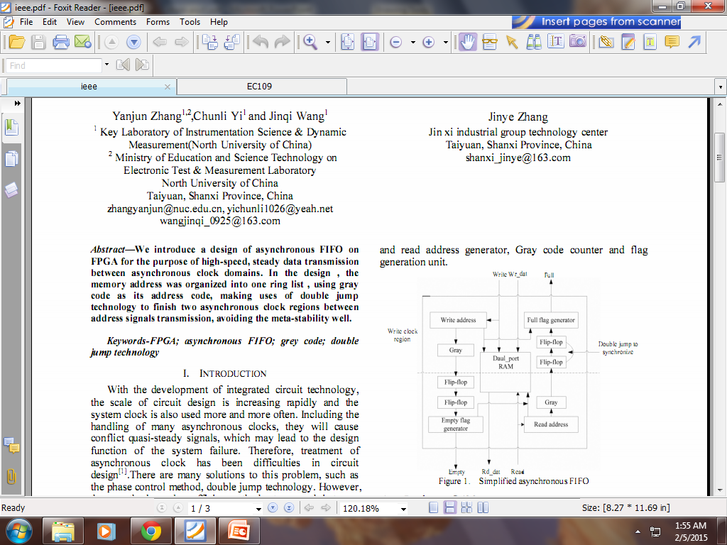
Block Diagram
fig: Asynchronous FIFO

Slide 6
Dual-port RAM
It has two ports A, B completely independent of each other and can read and write clock frequencies upto 100 MHz .
It is fast and simple design.
It can configure port A as write port and port B is configured as a read port.

Slide 7
State logic module
State logic module provides FIFO empty and full flag signal.
If there is a full signal, then the FIFO writes operation for the critical state, that there is no space to store data.
If there is an empty signal, then the FIFO reads operation for the critical state, that no more data can be read.
FIFO empty and full signal plays a very important role to read and write data to achieve their own independent operation.

Slide 8
Gray code counter
Gray code allows only one bit to change for each clock transition.
The code distance between any two adjacent words is 1.
Gray code is used to eliminate fuzziness in the circuit.
It is used because it is error free.

Slide 9
Synchronization design
Write address and read address is used to generate empty and full flag.
To ensure the synchronization of addresses, it is passed on to other clocks in the same region.
Problems like delaying of bits in a clock cycle may occur during synchronization of addresses.

Slide 10
Conclusion
Asynchronous FIFO presents the method detailed in the empty and full signal generator, the use of gray code to encode the address of reading and writing, using technology to complete the double jump between the regions address.
It operates at high speed, has high reliability, re-configurability, low development cost and consumes low power.

Slide 11
References
“Asynchronous FIFO Implementation Using FPGA” Yanjun Zhang!,2,Chunli Yi! and Jinqi Wang! 1 Key Laboratory of Instrumentation Science & Dynamic Measurement(North University of China) 2 Ministry of Education and Science Technology on Electronic Test & Measurement Laboratory North University of China Taiyuan, Shanxi Province, China.
Nobutaro Shibata.maynmi watanabe. A current-sensed high speed and low-power first in first out memory using a wordline/bitline-swapped dual-port sram cell. IEEE Journal of Solid State Circuites. VOL 37, NO. 6, JUNE 2002.

Slide 12
Thank You

